Slide 1
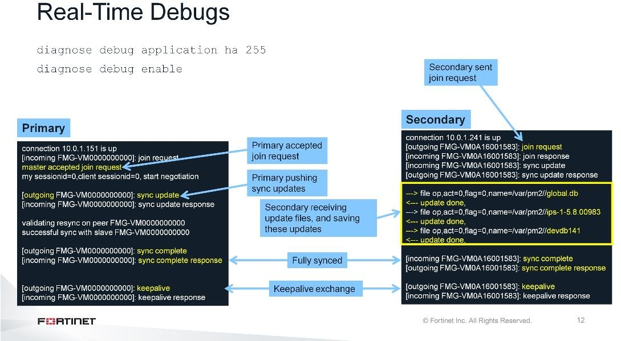
DO NOT REPRINT
© FORTINET
Additional Configuration
You can use the real-time debug commands to check sync issues and for keep alive massages.
In the example shown on this slide, a new secondary FortiManager is configured and sending a request to the primary FortiManager to join the cluster. The primary FortiManager accepts the request and sends the databases to the secondary FortiManager. Then, the secondary FortiManager saves these databases and updates the primary FortiManager. After the primary and secondary devices are fully synced, cluster members exchange keepalive messages, which confirms the cluster is up and running.
The failure is detected after you configure the heartbeat interval multiplied by the failover threshold in the HA settings on the primary FortiManager.

Slide 2
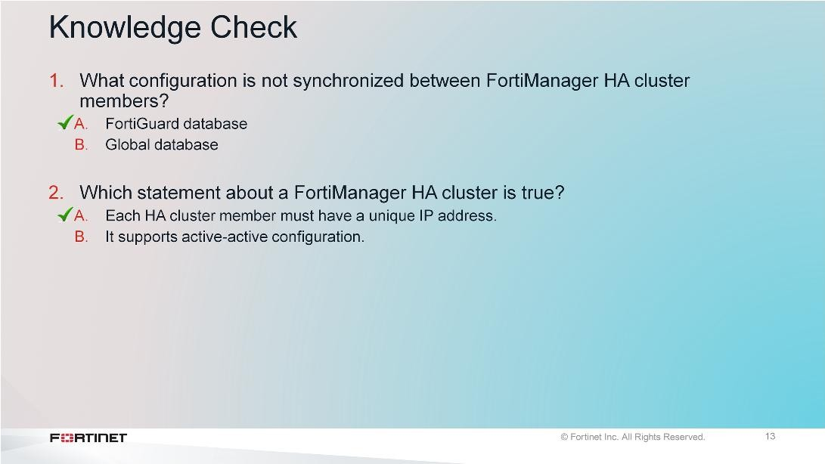
DO NOT REPRINT
© FORTINET
Additional Configuration

Slide 3
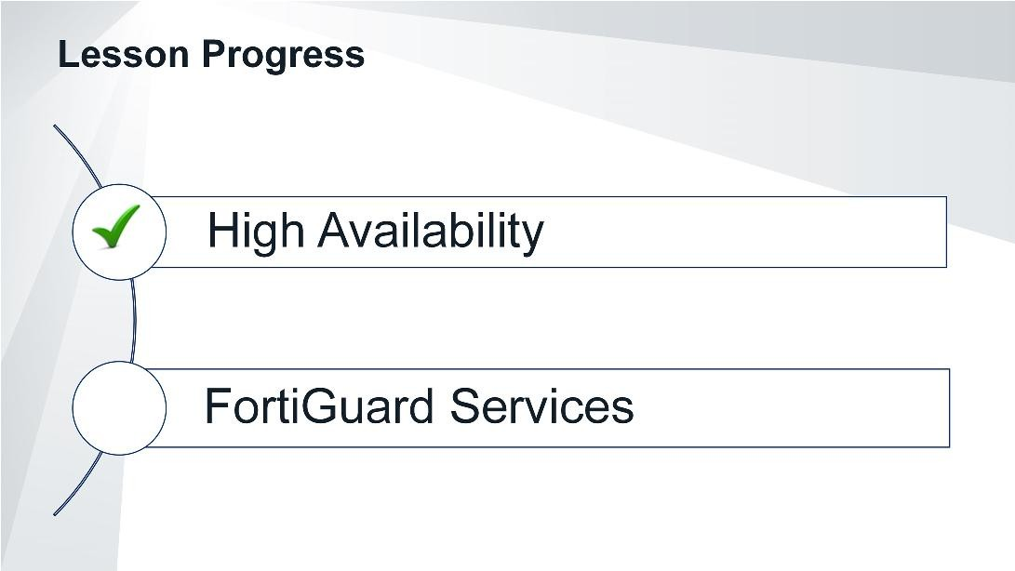
DO NOT REPRINT
© FORTINET
Additional Configuration
Good job! You now understand how to implement, configure, and troubleshoot HA cluster.
Now, you will learn FortiGuard services.

Slide 4
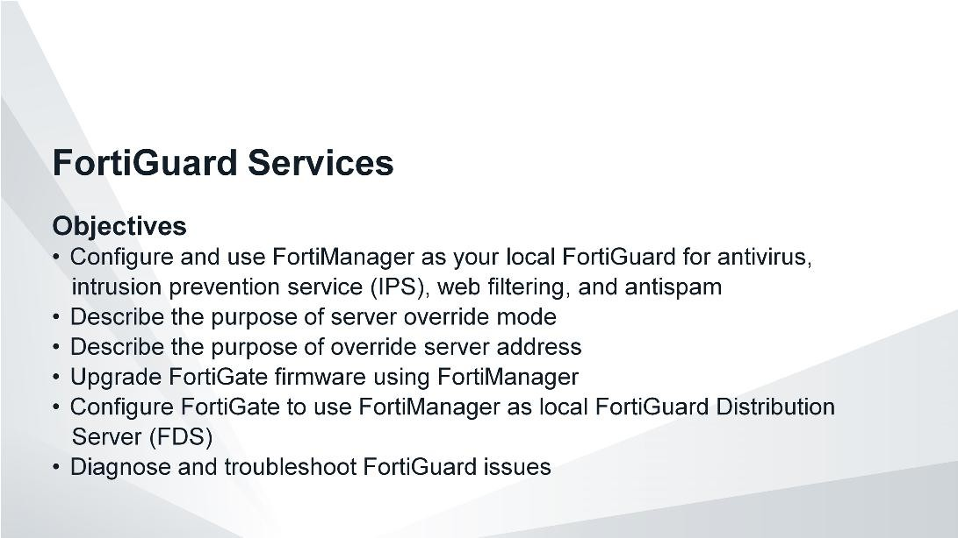
DO NOT REPRINT
© FORTINET
Additional Configuration
After completing this section, you should be able to achieve the objectives shown on this slide.
By demonstrating competence in using FortiGuard services on FortiManager, you will be able to use your FortiManager effectively as a local FDS server.

Slide 5
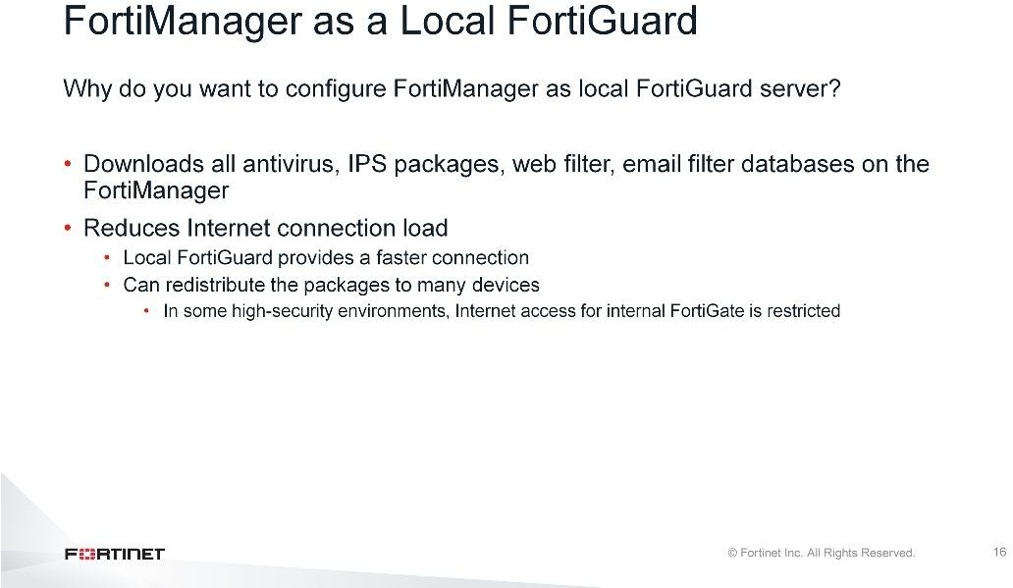
DO NOT REPRINT
© FORTINET
Additional Configuration
A FortiManager that is acting as a local FortiGuard synchronizes the FortiGuard updates and packages with the public FortiGuard Distribution Network (FDN), then provides the updates to your private network’s supported Fortinet devices. The local FortiGuard provides a faster connection, which reduces the Internet connection load and the time required to apply updates, such as IPS signatures, to many devices.

Slide 6
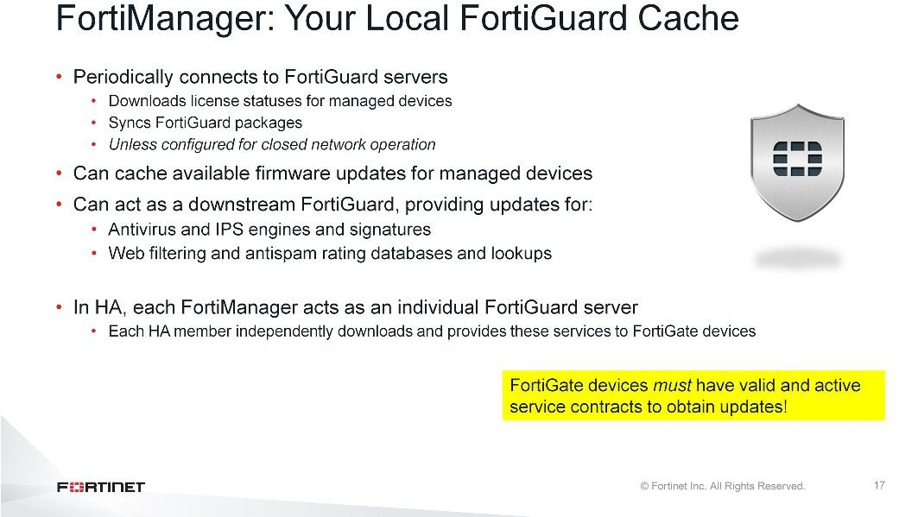
DO NOT REPRINT
© FORTINET
Additional Configuration
FortiManager can function as a local FortiGuard Distribution Server (FDS). It continuously connects to the public FDN servers to obtain managed device license information and check firmware availability updates (unless configured for closed-network operations).
FortiManager can provide antivirus, IPS signature updates, web filtering, and anti-spam services to supported devices.
FortiGuard information is not synchronized across a FortiManager cluster. In a cluster, each device individually downloads and can provide these services independently.
FortiManager supports requests from registered (managed) and unregistered (unmanaged) devices.
Use of FortiGuard services on FortiManager may be resource intensive and, moreover, you may dedicate a FortiManager to this task.

Slide 7
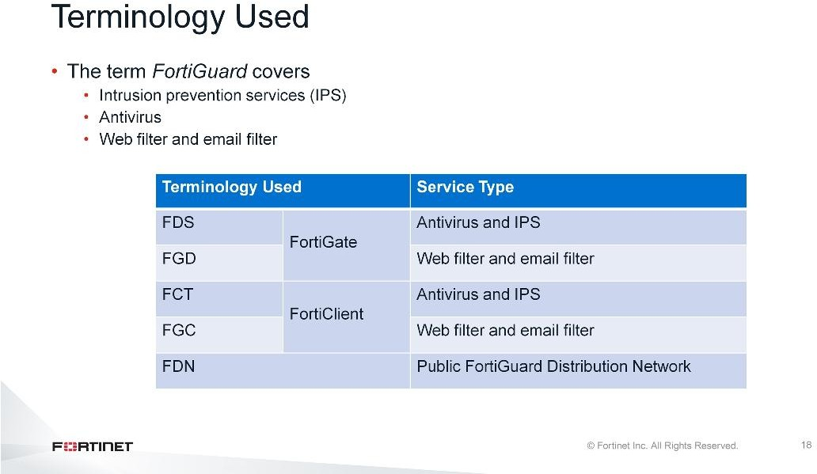
DO NOT REPRINT
© FORTINET
Additional Configuration
FortiGuard services represent the antivirus, IPS, web-filtering, and anti-spam update services.
Historically, the antivirus and IPS service has been referred to as the FDS service, and the web filter and email filter service as the FortiGuard service.
Currently, the term FortiGuard covers all services; however, specific FortiManager GUI or CLI configuration sections still continue to refer to them using the terminology shown on this slide.

Slide 8
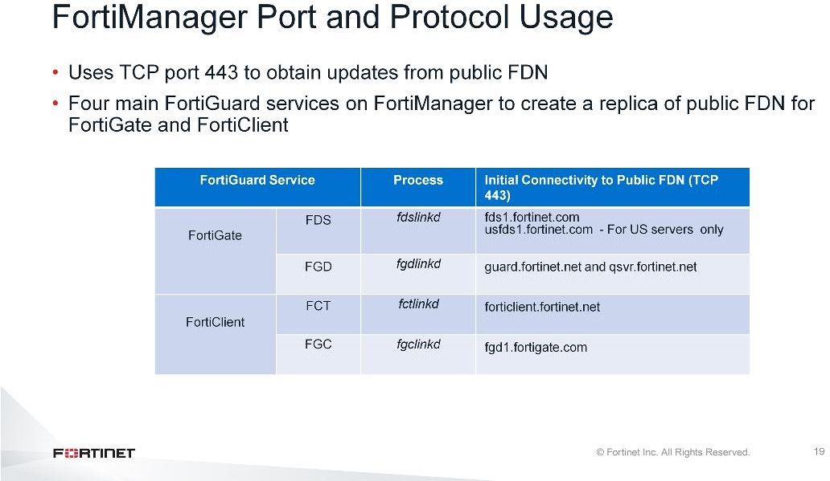
DO NOT REPRINT
© FORTINET
Additional Configuration
FortiManager requires Internet access using TCP port 443 in order to download packages and databases, and validate FortiGate service licenses, from public FDN servers.
FortiManager uses four main FortiGuard services to create a replica of public FDN servers for FortiGate and FortiClient.

Slide 9
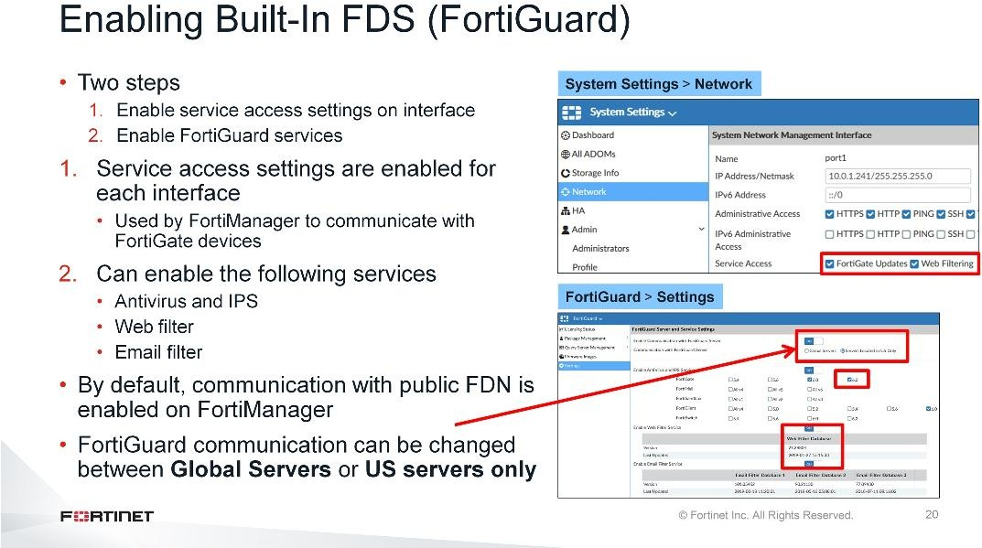
DO NOT REPRINT
© FORTINET
Additional Configuration
In order to enable the built-in FDS, you must enable the service access setting on the FortiManager interface and the FortiGuard services.
You must configure the Service Access settings on FortiManager per interface. This is useful when different FortiGate devices are communicating with FortiManager on different interfaces. FortiGuard services are used by FortiGate devices to query and obtain updates from FortiManager. The FortiGate Updates service is for antivirus, IPS, and license validation. The Web Filtering service is for web filter and antispam.
The second configuration step is to enable services on FortiManager. By default, communication to the public FDN is enabled, which allows FortiManager to continuously connect to FDN servers to obtain managed device information and sync packages. However, you must enable services such as antivirus and IPS, web filter, and email filter so that FortiManager can download updates for these services from the public FDN.
You can select Servers Located in the US Only to limit communication to FortiGuard servers located in the USA. Select Global Servers to communicate with servers anywhere.
When you use FortiManager in a closed network, disable communication with FortiGuard. When communication is disabled, you must upload antivirus, IPS, license packages, web filter, and email filter databases manually because they are no longer automatically retrieved from the public FDN server(s).
During the first-time setup, FortiManager is still receiving updates from the public FDN, you should disable service access at the interface level. This is because FortiManager is still downloading updates and may not be able to provide accurate ratings or updates to FortiGate. You can enable service access after FortiManager has downloaded the packages and databases.

Slide 10
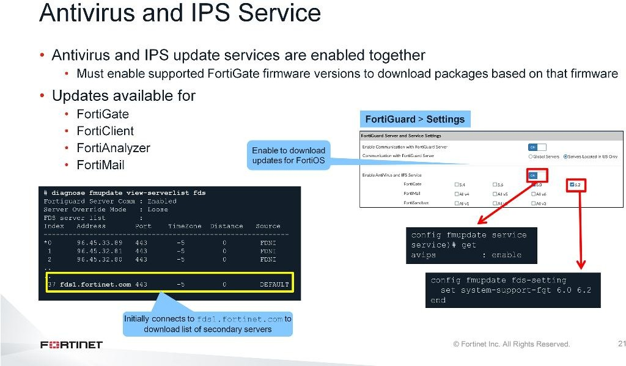
DO NOT REPRINT
© FORTINET
Additional Configuration
The antivirus and IPS services are enabled together and use TCP port 443 to obtain the updates from public FDN. You can enable updates for the supported products by enabling the firmware version that you want to download the updates for.
By default, FortiManager will first attempt to connect to the public FDS server fds1.fortinet.com through TCP port 443, to download the list of secondary FDS servers that it will download AV/IPS packages from.

Slide 11
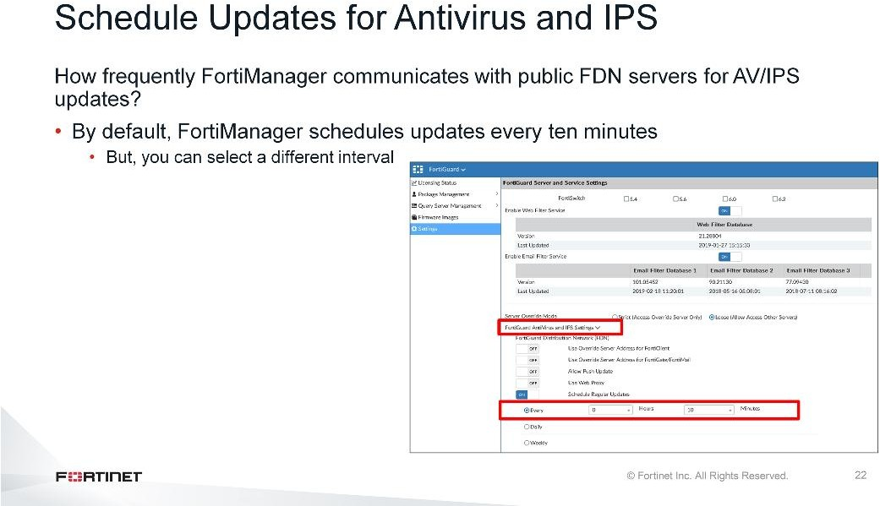
DO NOT REPRINT
© FORTINET
Additional Configuration
Keeping the built-in FDS up-to-date is important to provide current FDS update packages. By enabling Schedule Regular Updates, you are guaranteed to have a relatively recent version of signature and package updates. A FortiManager system acting as an FDS synchronizes its local copies of FortiGuard update packages with the FDN when:
FortiManager is scheduled to poll or update its local copies of update packages
If push updates are enabled (it receives an update notification from the FDN)
If the network is interrupted when FortiManager is downloading a large file, FortiManager downloads all files again when the network resumes. You can configure scheduled updates on an hourly, daily, or weekly schedule.
By default, FortiManager schedules updates every ten minutes because antivirus updates occur frequently.
What if there are important IPS updates available on the public FortiGuard, how can you ensure FortiManager to always receive new updates?

Slide 12
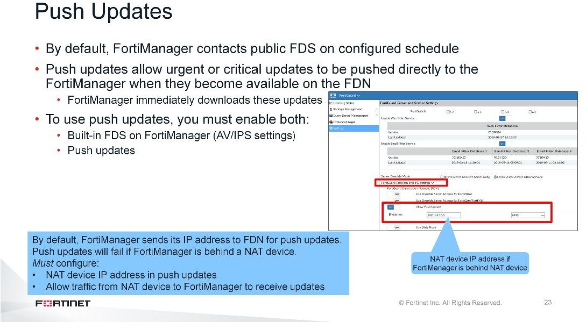
DO NOT REPRINT
© FORTINET
Additional Configuration
If you enable Allow Push Update, the FDN can push update notifications to FortiManager’s built-in FDS, as soon as new signature updates are released publicly by FortiGuard. FortiManager then downloads the updates immediately.
Usually, when push updates are enabled, FortiManager sends its IP address to the FDN; this IP address is used by the FDN as the destination for push messages.
What if FortiManager is behind a NAT device?
If FortiManager is behind a NAT device, sending its IP address for push updates will cause push updates to fail because this is a non-routable IP address from the FDN. You must configure the following:
On FortiManager, configure the NAT device IP address and port used for push updates. By default, the port for push updates is UDP 9443, but you can configure a different port number.
On the NAT device, configure the virtual IP and port that forwards to FortiManager. FortiManager may not receive push updates if the external IP address of the NAT device changes.
The built-in FDS may not receive push updates if the external IP address of any intermediary NAT device is dynamic (such as an IP address from PPPoE or DHCP). When the NAT device’s external IP address changes, FortiManager’s push IP address configuration becomes out-of-date.

Slide 13
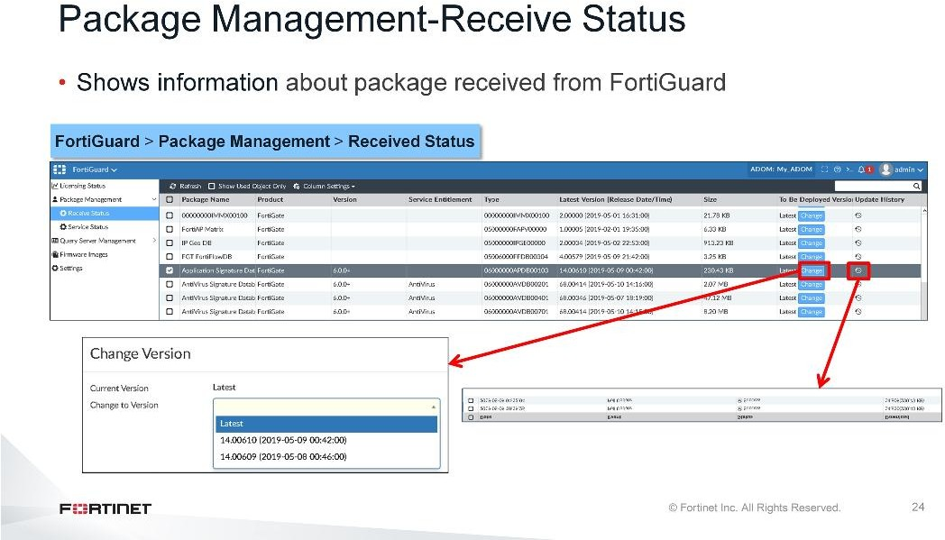
DO NOT REPRINT
© FORTINET
Additional Configuration
The Receive Status displays the package received, latest version, size, to be deployed version, and update history for the antivirus and IPS signature packages received from FortiGuard.
The Update History shows the update times, the events that occurred, the status of the updates, and the versions downloaded.
You can also change the version you want to deploy.

Slide 14
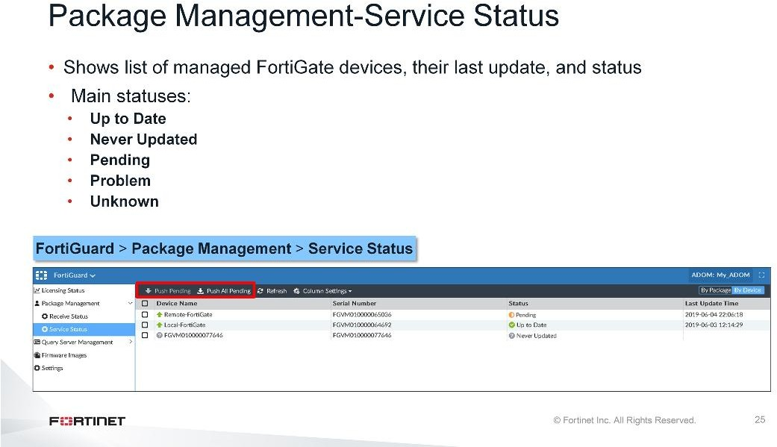
DO NOT REPRINT
© FORTINET
Additional Configuration
There are five main statuses for FortiGate devices configured to receive updates from the FortiManager:
Up to Date: The latest package has been received by the FortiGate device
Never Updated: The device has never requested or received the package
Pending: The FortiGate device has an older version of the package because of an acceptable reason (such as the scheduled update time is pending)
Problem: The FortiGate device missed the scheduled query, or did not correctly receive the latest package
Unknown: The FortiGate device’s status is not currently known
You can also push pending updates to the devices, either individually or all at the same time.

Slide 15
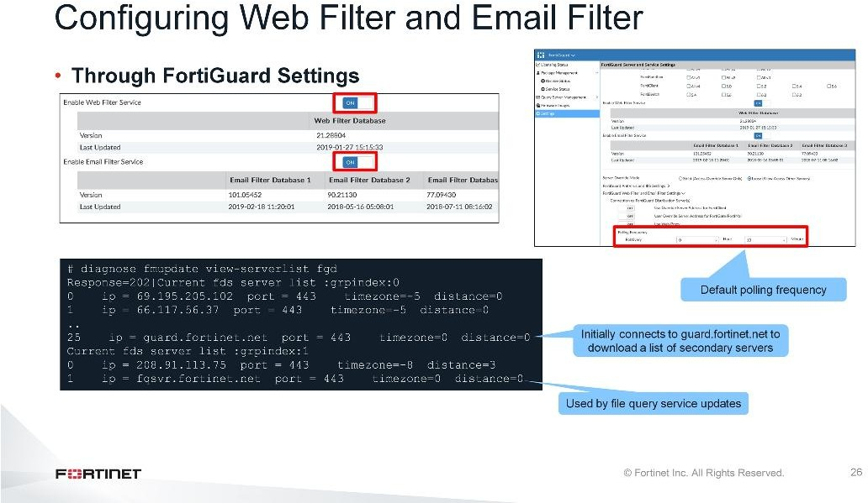
DO NOT REPRINT
© FORTINET
Additional Configuration
You must enable the web filter and email filter services individually. By default, FortiManager first attempts to connect to the public FGD server over TCP port 443 to download the list of secondary FGD servers from which it will then download web and antispam packages. By default, FortiManager is scheduled to check for updates every 10 minutes.

Slide 16
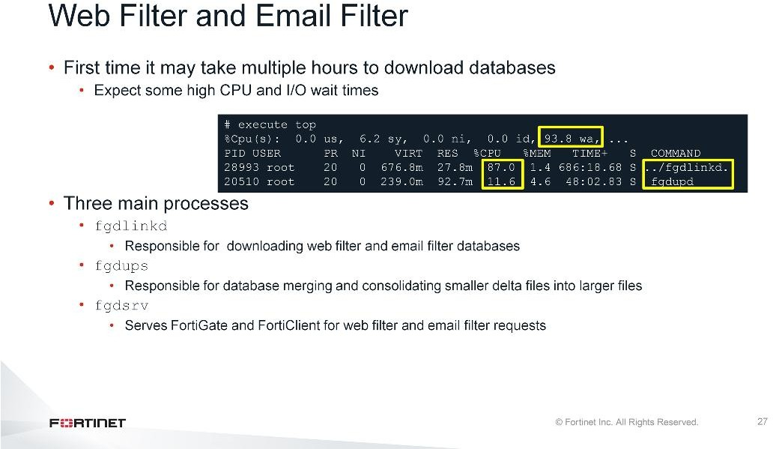
DO NOT REPRINT
© FORTINET
Additional Configuration
When you enable web and anti spam services for the first time, it may take several hours to download and merge the databases. During this time, you will notice higher I/O wait times and a spike in CPU usage related to web and email processes on FortiManager.

Slide 17
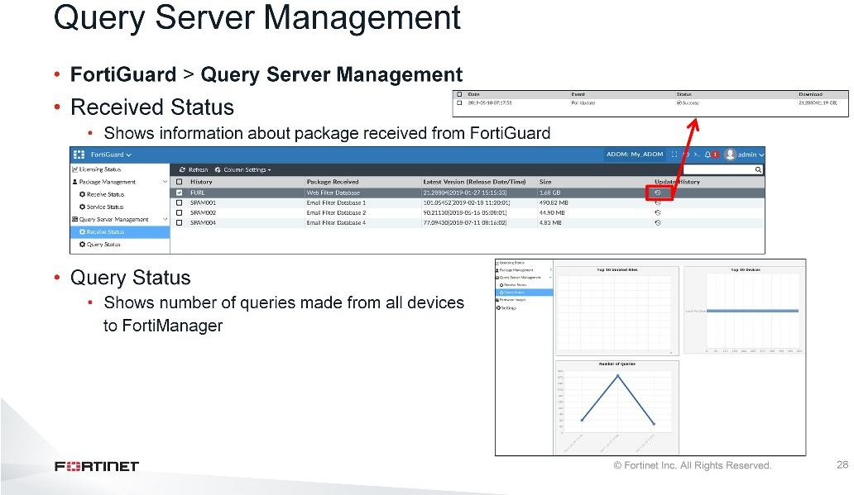
DO NOT REPRINT
© FORTINET
Additional Configuration
The web and antispam databases received from FortiGuard are listed under Receive Status. The date and time updates are received from the server, the update version, the size of the update, and the update history are also shown. You can click Update History to see more information about individual packages downloaded.
The Query Status shows the number of queries made from all managed devices to the FortiManager device that is acting as a local FDS.

Slide 18
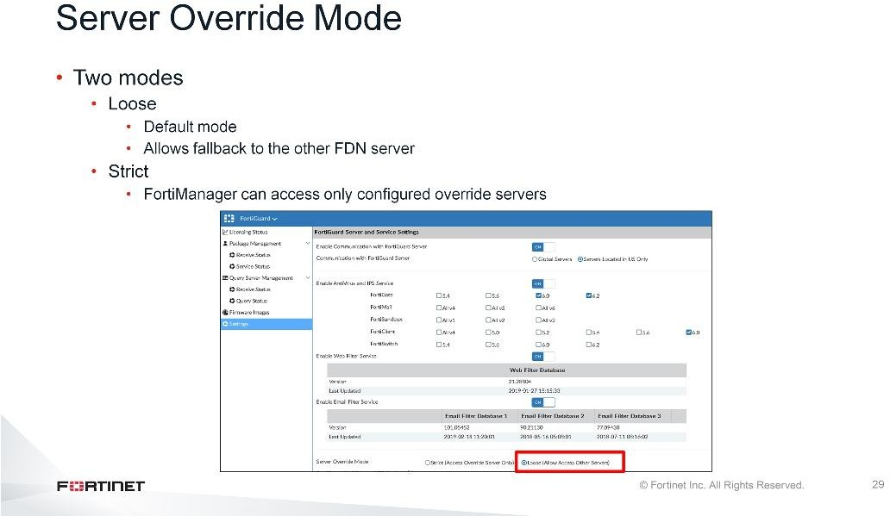
DO NOT REPRINT
© FORTINET
Additional Configuration
By default, Server Override Mode is set to Loose and is the recommended mode. This setting allows FortiManager to fall back to the other FDN servers if FortiManager is not able to communicate with one of the configured servers in the override server address list.
You can change the Server Override Mode to Strict, which prevents the fallback from occurring. This setting allows FortiManager to communicate only with the servers configured in the override server address list.

Slide 19
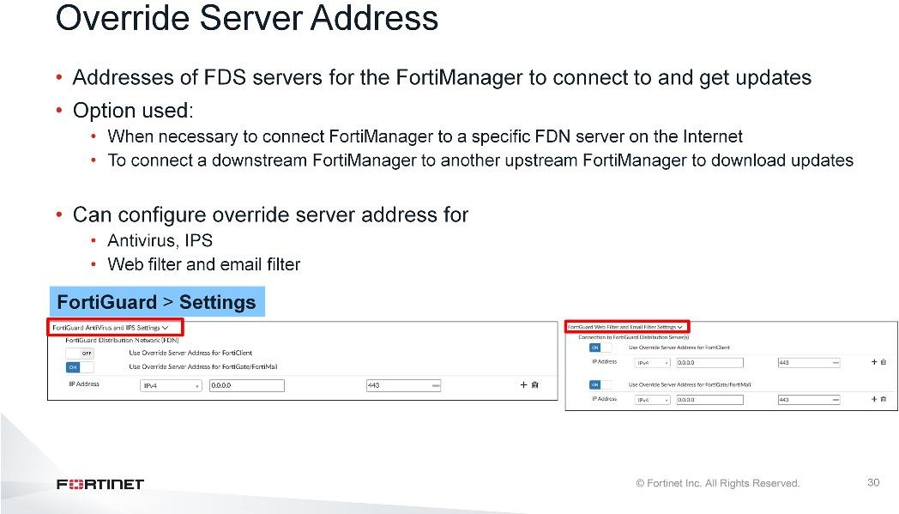
DO NOT REPRINT
© FORTINET
Additional Configuration
You can configure an override server address, which allows FortiManager to communicate to the servers listed in the override servers. You can configure the override server addresses for antivirus, IPS, web filter, and email filter for FortiGate, FortiMail, and FortiClient.
An example of a good situation in which to configure an override server address is if you have a dedicated upstream FortiManager that you use to download antivirus and IPS updates. In this case, you can configure your downstream FortiManager to get the updates from the dedicated upstream FortiManager by configuring the IP address and port used by the upstream FortiManager.

Slide 20
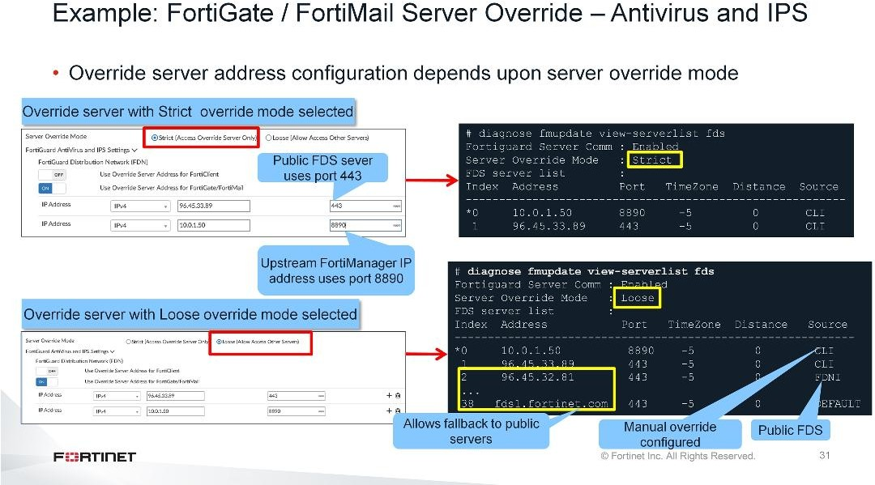
DO NOT REPRINT
© FORTINET
Additional Configuration
FortiManager tries to obtain updates from the servers configured in the Use Override Server Address for FortiGate/FortiMail section. Depending upon the Server Override Mode configuration, you can restrict FortiManager to get updates from the configured override servers list, or allow fallback to other public FDS servers, if FortiManager is not able to communicate to get updates from the configured server list.
In the example shown on this slide, two override server addresses are configured. When Server Override Mode is set to Strict, FortiManager gets updates only from these two servers. There is no fallback to other public servers, if these two configured servers are not available.
If you set Server Override Mode to Loose, FortiManager will first try to get updates from the configured server list, and, if they are unavailable, FortiManager will fall back to other public FDS servers to get updates.

Slide 21
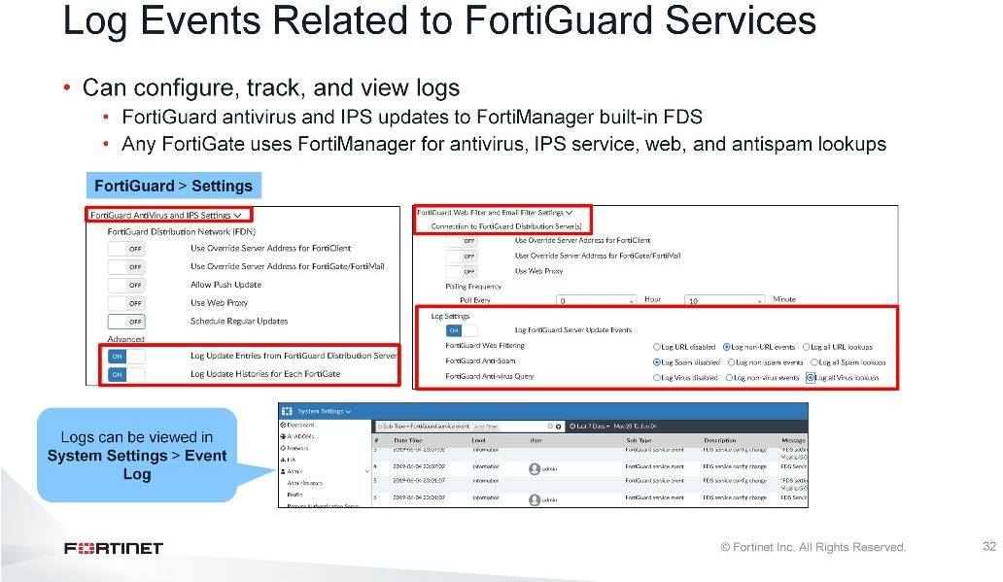
DO NOT REPRINT
© FORTINET
Additional Configuration
You can configure logging of FortiGuard events, such as FortiManager built-in FDS updates, and FortiGate devices using FortiManager as an FDS.
You can view the logs in Event Logs, which can be helpful in diagnosing or troubleshooting issues related to FortiGuard updates.

Slide 22
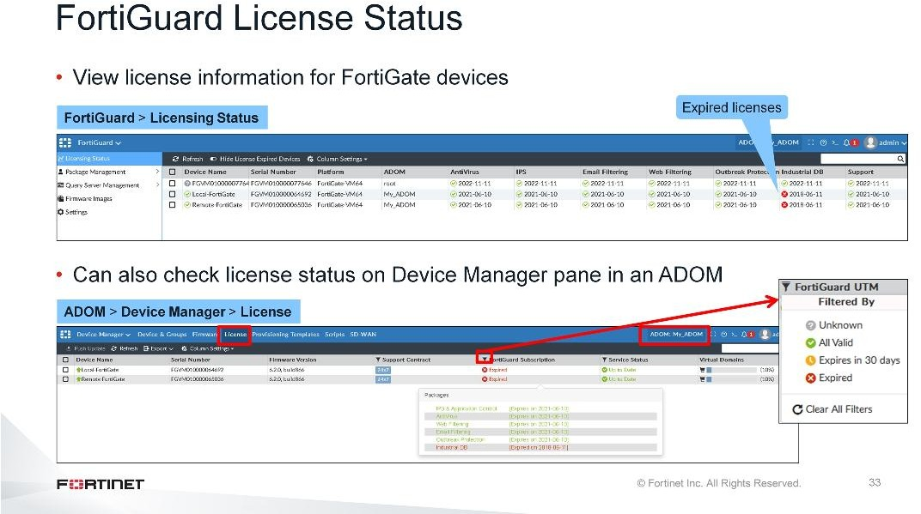
DO NOT REPRINT
© FORTINET
Additional Configuration
FortiManager includes a licensing overview page that allows you to view license information for all managed FortiGate devices. You can quickly verify if the FortiGate license has expired or not.
If you have access to your ADOM only, the administrator can view the license information of FortiGate devices in their ADOM. If you are managing many FortiGate devices in an ADOM, you can use filters to check the statuses. For example, you can check service licenses for the FortiGate devices expiring in the next 30 days. This helps you to take proactive steps to renew the licenses.

Slide 23
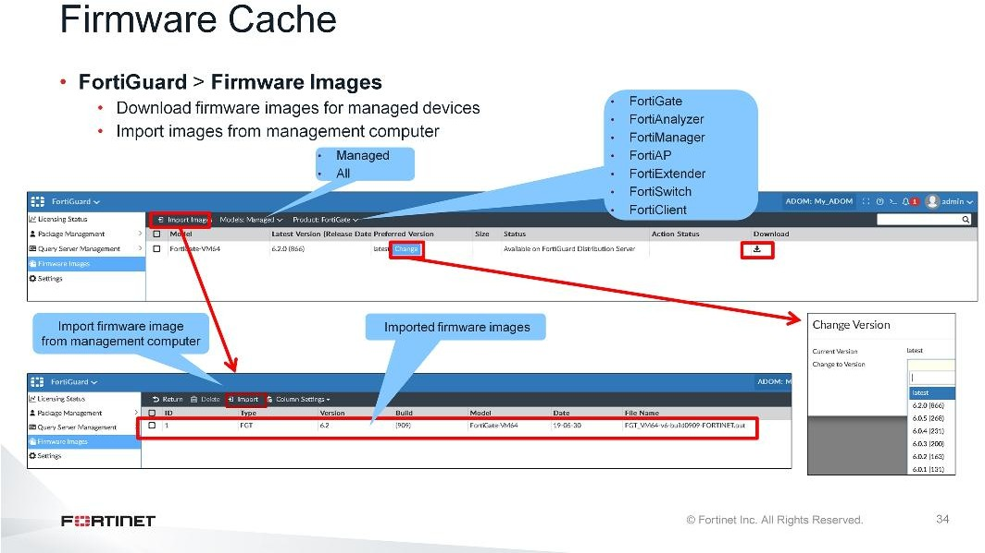
DO NOT REPRINT
© FORTINET
Additional Configuration
FortiManager can download images from the FDN, or you can upload firmware images from your management computer. If the latest firmware doesn’t suit your needs, you can change the latest firmware or you can import firmware images from your management computer. This allows you to change the device firmware using your FortiManager device.
You can view the available firmware based on the supported product type, and filter for all devices or only managed devices.

Slide 24
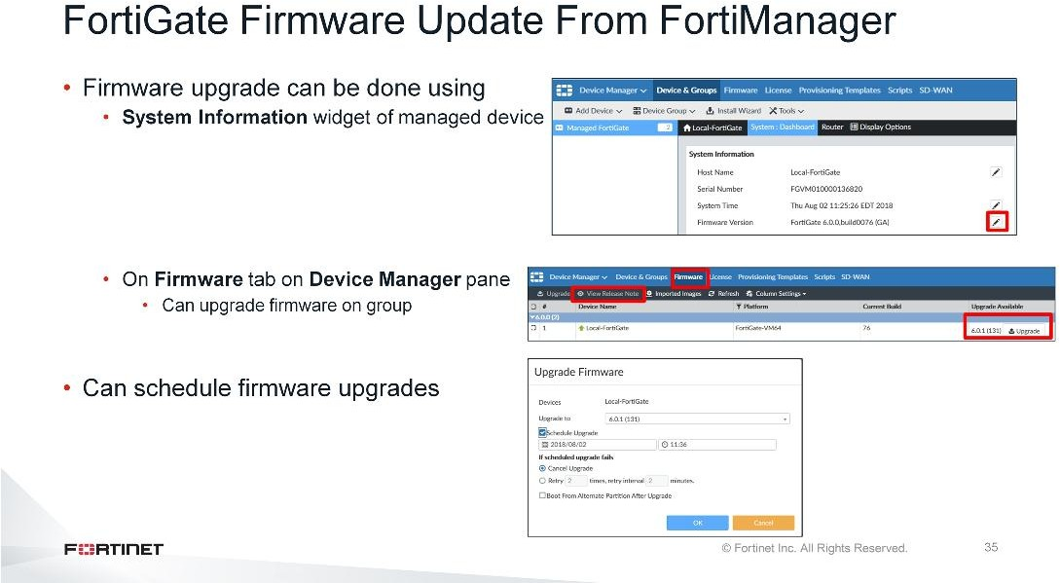
DO NOT REPRINT
© FORTINET
Additional Configuration
You can upgrade the FortiGate firmware in two ways:
For each device, using the System Information widget
For multiple devices, on the Firmware tab in the ADOM. You can upgrade the firmware version of all the FortiGate devices, selected FortiGate devices, or FortiGate devices in a group.
FortiManager allows you to upgrade the firmware now, or schedule the upgrade. You can also configure FortiManager to retry in case the first attempt to upgrade the firmware is unsuccessful (which can be caused by network interruptions or FortiGate being unable to communicate with FortiManager).

Slide 25
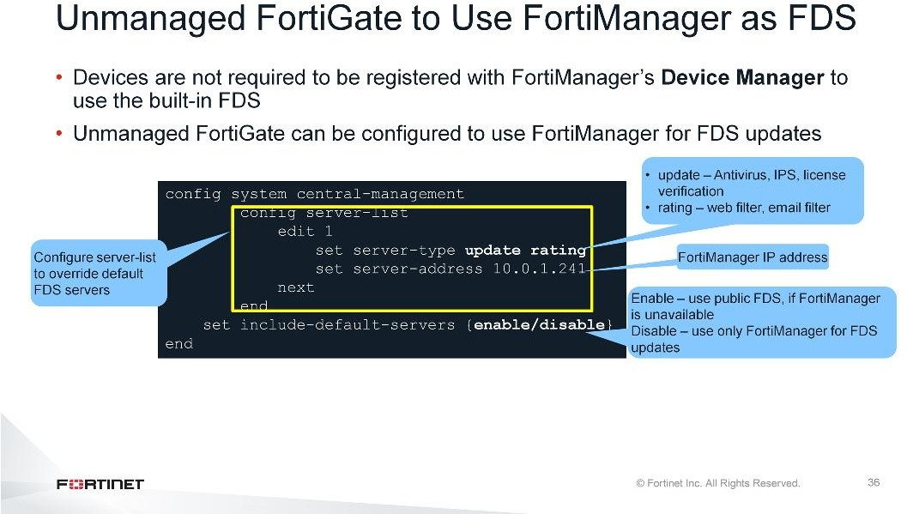
DO NOT REPRINT
© FORTINET
Additional Configuration
You can also configure unmanaged FortiGate devices to use FortiManager as a local FDS. You must configure the server-list in the central-management settings of FortiGate, which includes:
IP address of FortiManager used as local FDS for FortiGate devices
Server type, which includes:
update — used for antivirus, IPS updates, and FortiGate license verification
rating — used for web filter or anti-spam rating
By default, include-default-servers is enabled, which allows a FortiGate to communicate with the public FortiGuard servers if a private server (configured in the server-list) is unavailable. You can enable or disable inclusion of public FortiGuard servers in the override server list.

Slide 26
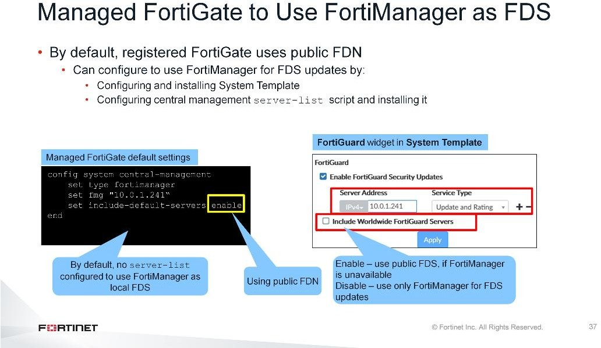
DO NOT REPRINT
© FORTINET
Additional Configuration
By default, when a FortiGate is managed by FortiManager, it uses public FortiGuard servers. This is because not every organization uses FortiManager for local FDS.
There are multiple ways to configure FortiGate to use FortiManager as a local FDS. You can:
Configure FortiGuard settings in the FortiGuard widget, which you can assign to and install on managed devices. The decision to override the default FDS server and use FortiManager is a device-level setting. Remember to enable service access settings on the FortiManager interface.
Configure and install a script for the central management server-list.

Slide 27
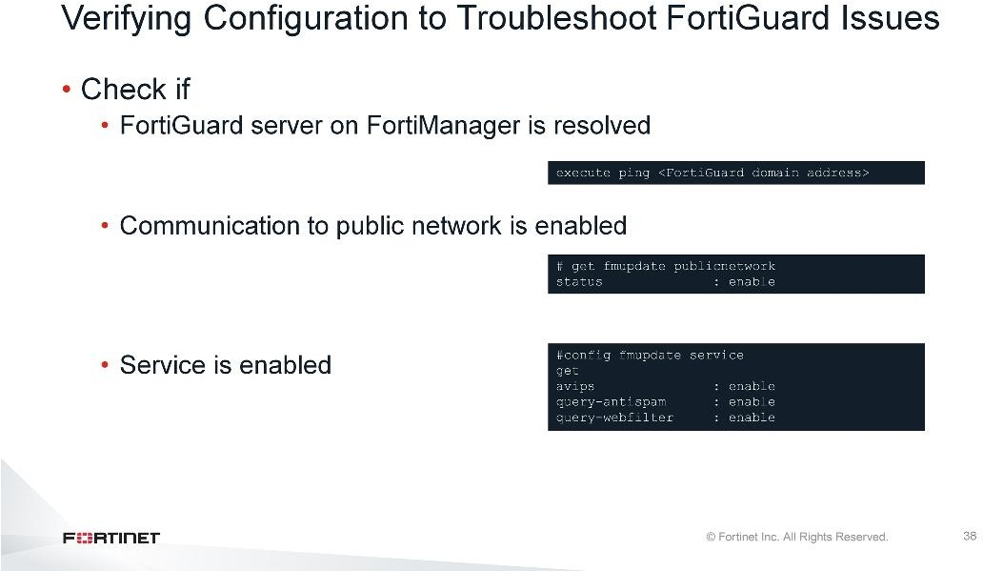
DO NOT REPRINT
© FORTINET
Additional Configuration
The first step you should perform when troubleshooting FortiGuard issues is to check and verify the configuration on FortiManager. You should check if:
You are able to resolve the public FDN servers by domain name. For example, check if you are able to ping fds1.fortinet.com for antivirus and IPS for FortiGate or FortiMail.
Communication to public network and services are enabled on FortiManager
Services are enabled on the FortiManager

Slide 28
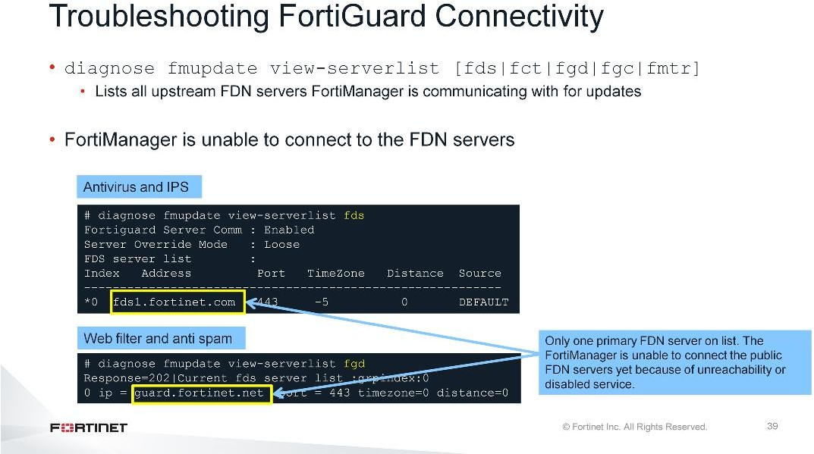
DO NOT REPRINT
© FORTINET
Additional Configuration
After you verify the configuration, check if FortiManager is communicating with the upstream FortiGuard server(s).
If FortiManager is unable to connect to the public FDN servers, only primary FDN servers will display in the server list. This can be caused by the FortiManager being unreachable or disabled services on FortiManager.
After FortiManager connects to the public FDN servers, it will download the list of secondary FDN servers from which it downloads the updates and packages.

Slide 29
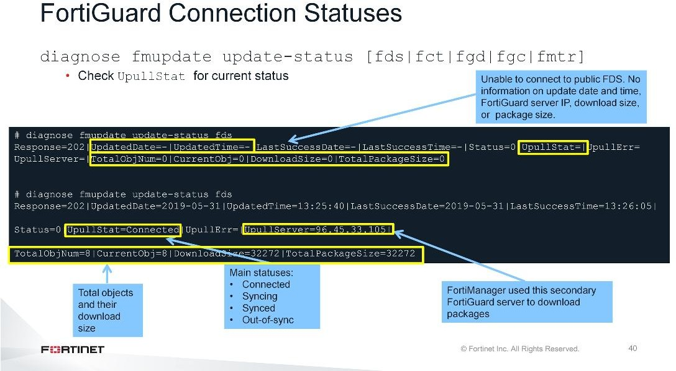
DO NOT REPRINT
© FORTINET
Additional Configuration
You can also check the status of the connection to the public FDN. If FortiManager is not able to connect to the public FDN, or the service is disabled, the UpullStat for the current status will be empty and there will be no information on the date, time, download size, and package.
After FortiManager is able to communicate with the public FDN, FortiManager will display the download size, package, and IP address of the FDN server that FortiManager is communicating with to download the updates.
The UpullStat has four main statuses:
Connected: The FortiManager connection to FDN initially succeeds, but a synchronization connection has not yet occurred.
Syncing: The built-in FDS is enabled, and FortiManager is downloading and syncing packages available on the FDN.
Synced: The built-in FDS is enabled and the FDN packages download successfully.
Out-of-sync: The initial FDN connection succeeds, but the built-in FDS is disabled.

Slide 30
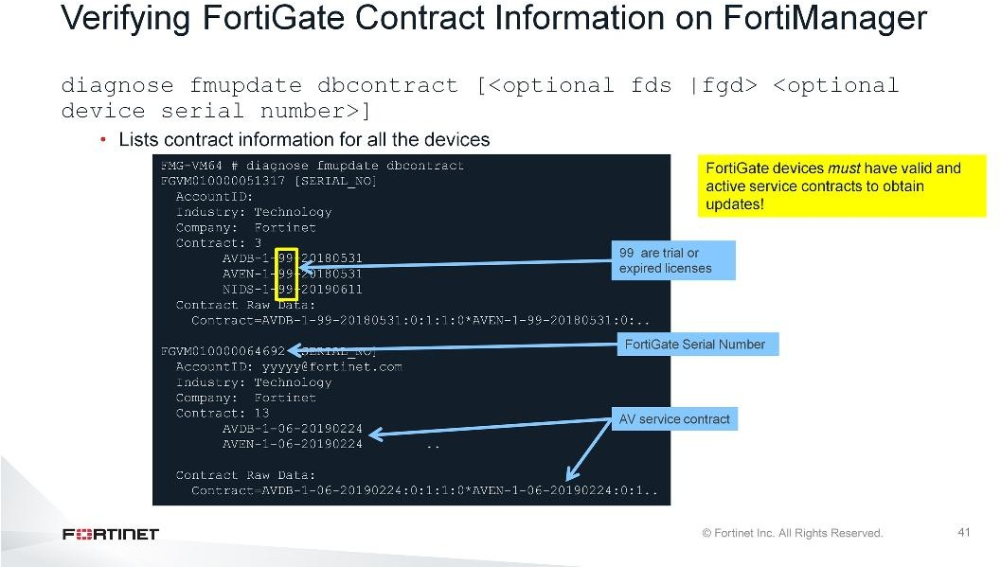
DO NOT REPRINT
© FORTINET
Additional Configuration
FortiGate devices must have valid and active service contracts to receive updates from FortiManager.
You can check the contract information of all FortiGate devices in the FortiManager CLI. An expired or trial FortiGate license shows as 99, which means FortiGate is unable to receive the updates from FortiManager.

Slide 31
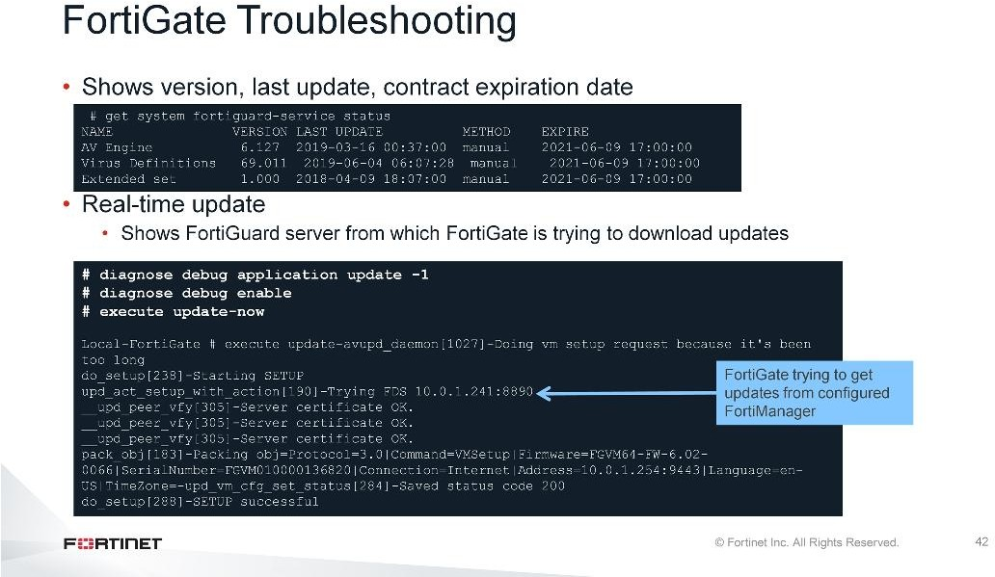
DO NOT REPRINT
© FORTINET
Additional Configuration
In the FortiGate CLI, you can check the version, when it was last updated, and contract information for FortiGate.
You can also run a real-time debug along with the update command, which will try to download the latest definitions and packages from the FDS server (or configured local FDS server in the central management configuration).

Slide 32
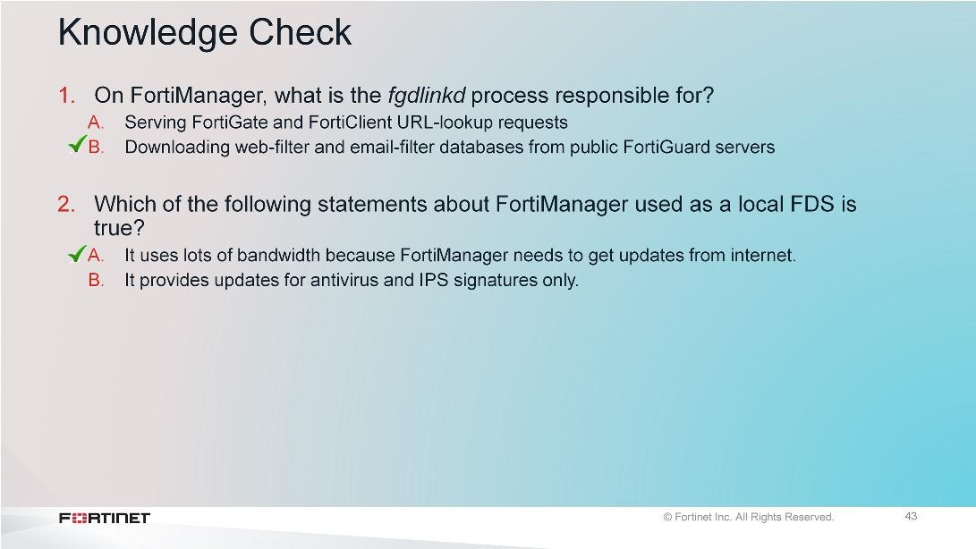
DO NOT REPRINT
© FORTINET
Additional Configuration

Slide 33
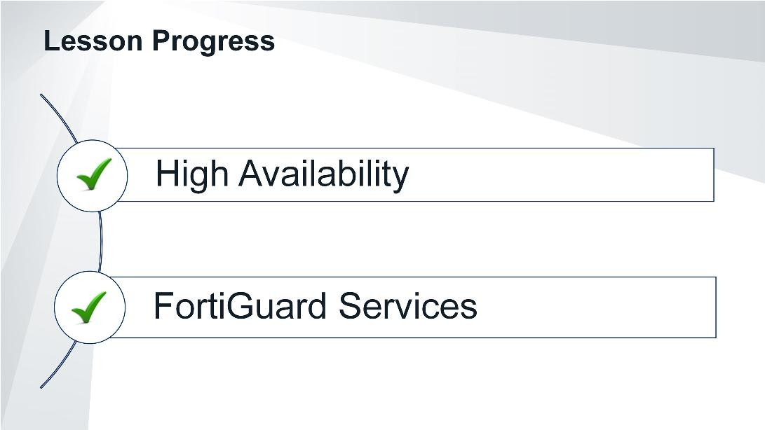
DO NOT REPRINT
© FORTINET
Additional Configuration
Congratulations! You have completed this lesson.
Now, you will review the objectives that you covered in this lesson.

Slide 34
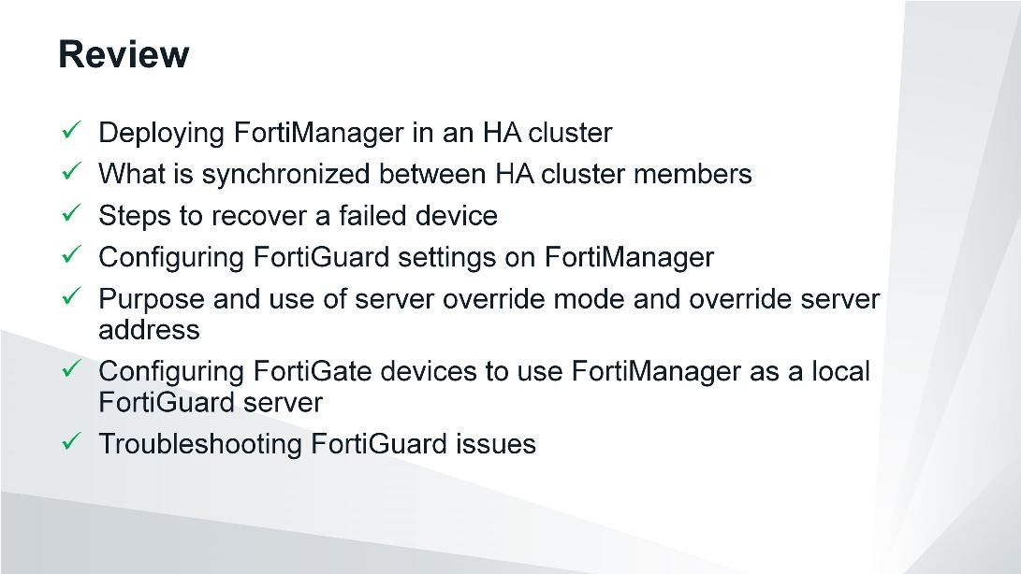
DO NOT REPRINT
© FORTINET
Additional Configuration
This slide shows the objectives that you covered in this lesson.

Slide 35



DO NOT REPRINT
© FORTINET
No part of this publication may be reproduced in any form or by any means or used to make any derivative such as translation, transformation, or adaptation without permission from Fortinet Inc., as stipulated by the United States Copyright Act of 1976.
Copyright© 2019 Fortinet, Inc. All rights reserved. Fortinet®, FortiGate®, FortiCare® and FortiGuard®, and certain other marks are registered trademarks of Fortinet, Inc., in the U.S. and other jurisdictions, and other Fortinet names herein may also be registered and/or common law trademarks of Fortinet. All other product or company names may be trademarks of their respective owners. Performance and other metrics contained herein were attained in internal lab tests under ideal conditions, and actual performance and other results may vary. Network variables, different network environments and other conditions may affect performance results. Nothing herein represents any binding commitment by Fortinet, and Fortinet disclaims all warranties, whether express or implied, except to the extent Fortinet enters a binding written contract, signed by Fortinet’s General Counsel, with a purchaser that expressly warrants that the identified product will perform according to certain expressly-identified performance metrics and, in such event, only the specific performance metrics expressly identified in such binding written contract shall be binding on Fortinet. For absolute clarity, any such warranty will be limited to performance in the same ideal conditions as in Fortinet’s internal lab tests. In no event does Fortinet make any commitment related to future deliverables, features, or development, and circumstances may change such that any forward-looking statements herein are not accurate. Fortinet disclaims in full any covenants, representations,and guarantees pursuant hereto, whether express or implied. Fortinet reserves the right to change, modify, transfer, or otherwise revise this publication without notice, and the most current version of the publication shall be applicable.

